Slide 1
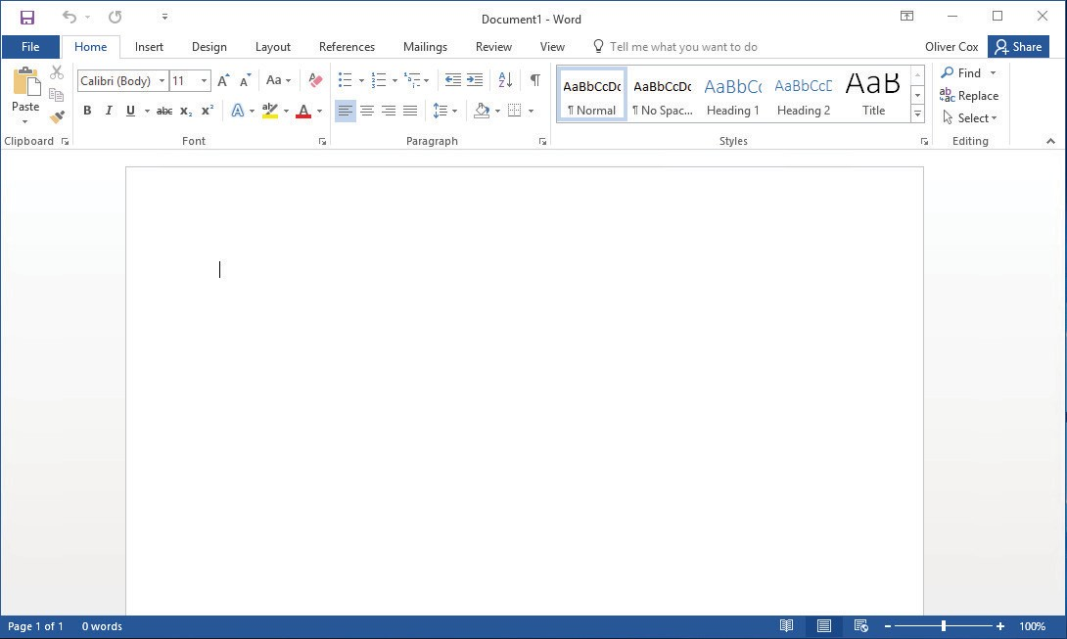
Understanding Word ₁
LESSON SKILL MATRIX
Skill | Exam Objective | Objective Number
Working with Tools | Customize the Quick Access toolbar. | 1.4.3
Creating a Document | Show or hide formatting symbols. | 1.4.6
 | Create a blank document. | 1.1.1
Saving a Document | Save documents in alternative file formats. | 1.5.2
Working with Templates | Create a blank document using a template. | 1.1.2
Previewing and Printing a Document | Modify print settings. | 1.5.1
 | Print all or part of a document. | 1.5.3
SOFTWARE ORIENTATION
Microsoft Word’s Primary User Interface
Before you begin working in Microsoft Word 2016, you need to acquaint yourself with the pri- mary user interface (UI). When you open a blank document in Microsoft Word 2016, you see a screen similar to that shown in Figure 1-1.
Document title
Microsoft account sign-in Collapse ribbon
Figure 1-1
Microsoft Word 2016 Opening screen
Quick access toolbar
Ribbon
Document page
Insertion point
Status bar Zoom slider
Microsoft has designed the Word UI to provide easy access to the commands you need most often when creating and editing documents. (Note that your screen might vary somewhat from the one shown here, depending on your program’s settings.) Use Figure 1-1 as a reference throughout this lesson as well as the rest of this book.
1

Slide 2
2
Lesson 1
STARTING WORD 2016
Microsoft Word is a word processing tool for creating diRerent types of documents that are used in work and school environments. The appearance of Microsoft Word 2016 is similar to Word 2010 and Word 2013, but with more enhanced features. It contains a customized Office Background that appears above the Ribbon, live access to your OneDrive account, an option to work in Read Mode, tab text that appears blue when active, a blue background for the status bar, and many more exciting new features. When you first launch Word, it opens with the Recent screen displayed. This screen enables you to create a new blank document or a document from a template. And when you exit a document and return later, Word 2016 resumes where you left oR.
Starting Word
In this exercise, you learn how to start Word using Windows 10.
In Windows 10, clicking the Start button displays the Start menu (see Figure 1-2). On this menu, you can choose which application to launch by using your mouse or, if you have a touch-screen monitor, by tapping the application you want to launch. The Start menu provides access to mail, OneDrive, Microsoft Edge , photos, games, music, video, and of course the latest version of the Microsoft Office applications. On tablets with Windows Mobile and the Office 2016 applications installed, you can customize the interface the same way as your Start menu.
If you don’t have Office 2016 installed on your computing device, you can still create, view, and perform simple edits on Word documents using an online Word Web App. Office Web Apps are available for Word, Excel, PowerPoint, and OneNote. You launch Office Web Apps using a web browser, such as Microsoft Edge. One of the diRerences between the Word Web App and the Word 2016 application installed on your computer is the number of features available. The Word Web App enables you to create, open, and edit documents with only the most basic commands. It is a wonderful way to create a simple document and share it. The main advantage of using the Word 2016 application installed on your computer is having full access to all the features needed to create a professional-looking document. If you use the Word Web App, you will not be able to complete all of the exercises in this book, because it does not include all of the Word features.
Microsoft has a cloud-based storage space known as OneDrive. Microsoft provides users with free online storage space, enabling you to manage your documents from anywhere and share them with anyone. Before you can use OneDrive, however, you must create a Microsoft account profile. Once you create your account, you will find it easy to manage and share your documents.
Windows 10 works seamlessly with Office 2016. When you are logged on to your Microsoft account, the account name appears in the upper-right corner of each Office 2016 application and you have access to the files you have stored in your OneDrive space. This makes it easy for you to continue working on your documents at any computer and reminds you where you left oR.
To begin using Word 2016, locate the Word icon and click it using the left mouse button or, if you are using a touch-screen monitor, tap the icon.
When Word is launched, the program opens with the Word 2016 screen (see Figure 1-3). On the left side of the screen under Recent, you see a list of documents that have been accessed recently. The right window pane displays a blank document page and several templates to create customized documents. To create a blank document, click the Blank document page and Word will open a new document.

Slide 3
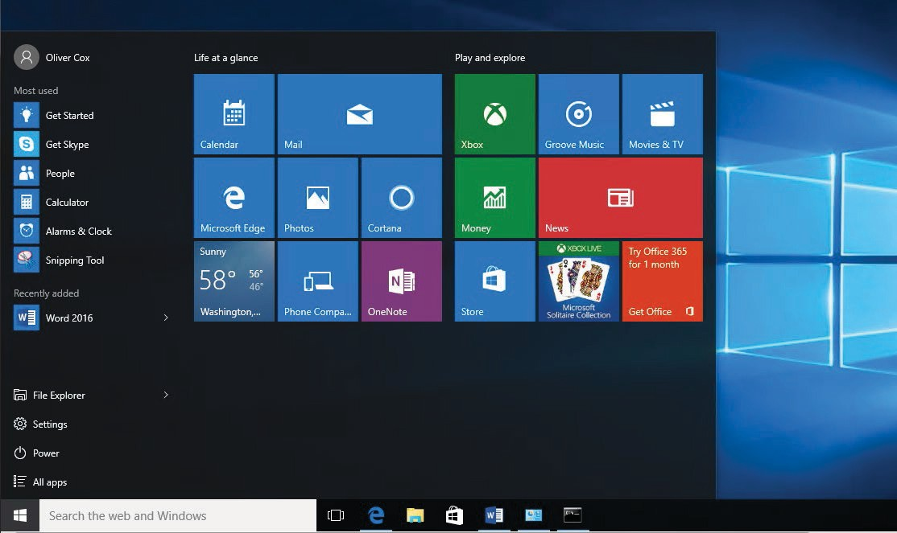
Understanding Word 3
The blinking insertion point in the upper-left corner of this document is where you begin creating your text. When you place your cursor near it, the insertion point changes to a large “I,” which is called the I-beam.
Take Note
The lessons in this book are created using the Windows 10 operating system. If your computer is running the Windows 8.1 or Windows 7 operating system, some screenshots and steps might appear slightly diRerent than those provided in this book.
STEP BY STEP Start Word
GET READY. Before you begin these steps, be sure to turn on and/or log on to your computer.
1. On the Windows 10 desktop, click the Start button. The Start menu appears (see Figure 1-2).
Figure 1-2
Start menu
Start Word
2. On the Start menu, locate Word 2016 and click the icon. The Word 2016 screen appears (see Figure 1-3). On the left side of the screen, you see the recent documents that have been accessed, and the right side displays the blank document page and templates.

Slide 4
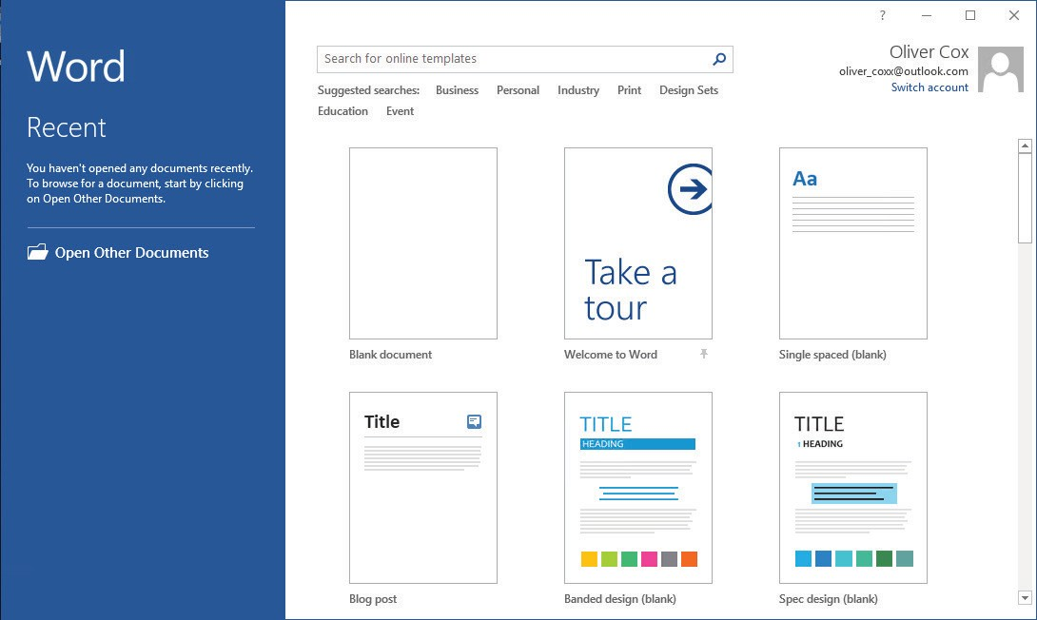
4 Lesson 1
Figure 1-3
Word 2016 screen
PAUSE. LEAVE the Word 2016 screen open to use in the next exercise.
Take Note
Windows 10 is for PC users at home, work, and school. It is a powerful tool that controls the user interface, storage devices, other software, peripheral devices, networks/security, system re- sources, and task scheduling. Windows 10 is the latest operating system standard for computers, laptops, and tablets. Windows 10 also comes in multiple versions, such as Windows 10 Home and Windows 10 Pro, to support your personal needs and how you use your device. Windows 10 supports touch-capable devices in addition to traditional mouse and keyboard commands.
WORKING WITH TOOLS
The Word 2016 window has many onscreen tools to help you create and edit documents quickly and efficiently. In this section, you learn how to locate and use the Ribbon and the Quick Access Toolbar to access Word commands. A command is an instruction based on an action that you perform in Word by clicking a button or entering information into a command box.
Using the Ribbon
In Word 2016, the Ribbon contains multiple commands on separate tabs. Microsoft has assigned each of its Office applications with a color. Word is symbolized with the color blue and active tab text is blue. Each tab contains several groups, or collections of related Word com- mands. For example, in the Home tab, the groups are labeled Clipboard, Font, Paragraph, Styles, and Editing. Each group contains one or more command icons, some of which have a drop-down
menu or a list of options associated with them; you click the drop-down arrow to display the
menu. Some groups have a dialog box launcher—a small arrow in the lower-right corner of the group—that you click to launch a dialog box that displays additional options or informa- tion you can use to execute a command.
In this exercise, you learn to use the Ribbon by making tabs active, hiding and displaying command groups, and using the dialog box launcher and drop-down arrows.
In the Office 2016 programs, the Ribbon is contextual, which means it displays commands related to the type of document or object that you have open and onscreen.

Slide 5
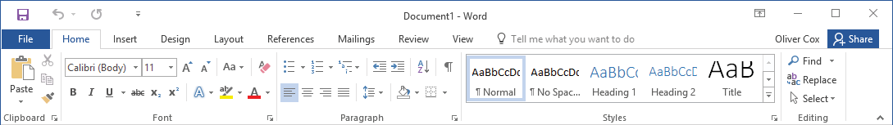
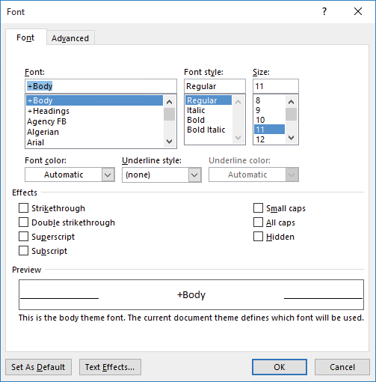
Understanding Word 5
STEP BY STEP Use the Ribbon
GET READY. Start with the File > New screen open.
1. Click the Blank document icon to create a new document file. The Ribbon is located at the top of the Word screen. In your newly opened document, the Home tab is the
default tab on the Ribbon, as shown in Figure 1-4. Note how the Ribbon is divided into groups: Clipboard, Font, Paragraph, Styles, and Editing.
Tab
Drop down arrow
Figure 1-4
The Ribbon
Command group
Dialog box launcher
Collapse ribbon
Review the other tabs on the Ribbon and review each group associated with the tab, and identify the arrows that launch a dialog box (if present).
Click the Layout tab to make it the active tab. Notice that the groups of commands change. The Layout tab contains three groups: Page Setup, Paragraph, and Arrange. Notice that in the Page Setup and Paragraph group a small arrow appears in the lower- right corner. Clicking on the arrow opens the dialog box with more options to select or complete a command.
Click the Home tab.
Click the dialog box launcher in the lower-right corner of the Font group. The Font dialog box, as shown in Figure 1-5, appears. The Font dialog box contains two tabs with the Font tab being the active tab. There are many options to select within the Font dialog box. You can click Cancel if you want to close the dialog box. We’ll continue without clicking Cancel.
Figure 1-5
Font dialog box
6. Click the drop-down arrow on the Font command box in the Font group to produce a menu of available fonts, as shown in Figure 1-6.

Slide 6
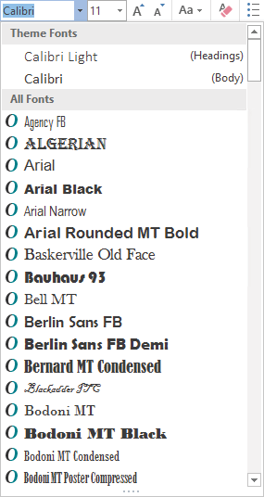
6 Lesson 1
Figure 1-6
Font menu
Displays list of available fonts
Scroll through list of available fonts
Click the arrow again to close the menu.
Double-click the Home tab. Notice that the command groups are now hidden, to give you more screen space to work on your document.
Double-click Home again to redisplay the groups.
PAUSE. LEAVE the document open to use in the next exercise.
After you create your first document, you see the filename on the document title bar, which displays as Document1. Word assigns chronological numbers to all subsequent files that you open in that session. When you save and name your documents, the name you assign replaces the document number name originally assigned by Word. When you close and reopen Word, the program begins its chronological numbering of new documents at number 1 again.
Using the Quick Access Toolbar
The Quick Access Toolbar is located above the Ribbon and contains commands that users access most often. By default, the Save, Undo, and Repeat commands display when you launch Word 2016. You can customize the contents of the Quick Access Toolbar by clicking the drop- down arrow on the right side of the toolbar and choosing options from the menu that appears.
Microsoft has included the Touch/Mouse Mode option to the Quick Access Toolbar in Word 2016. If you have a touch-capable device, you can use Touch Mode. Touch Mode provides more space between buttons and icons to prevent you from accidently pressing one with your finger or stylus. In this exercise, you learn to customize the Quick Access Toolbar. You also learn to change its position in relation to the Ribbon.
Clicking the Save button in the Quick Access Toolbar for the first time opens the Save As screen.
Save As also appears as a command listed in Backstage view when you click the File tab. When
saving a document for the first time, you need to specify the filename and location where the doc- ument will be saved. You can save a document to your local drive, your flash drive, OneDrive, or any other portable device. After you select a save location, the Save As dialog box lets you select a file format.

Slide 7
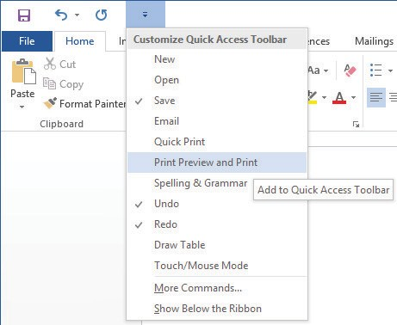
Understanding Word 7
The Undo command lets you cancel or undo your last Word command or action. You can click the Undo command as many times as necessary to undo previously executed commands. Also, if you click the arrow beside the Undo command, a history of actions you can undo appears. Click- ing the Repeat command repeats your last action. Note that commands on the Quick Access Toolbar are not available if their buttons are dimmed.
STEP BY STEP Use the Quick Access Toolbar
USE the document that is open from the previous exercise.
Click the Save button on the Quick Access Toolbar.
If this is the first time you’ve attempted to save this document, the Save As screen opens in Backstage. You have three options for where to save your work: OneDrive, This PC, or + Add a Place. For now, you are just exploring the Save command on the Quick Access Toolbar. Later in the lesson, you learn to save a document using the Save As command.
Click the Return to Document icon, which is a circled left arrow located in the upper- left corner, or press the Esc key to return to the document screen.
Click the drop-down arrow on the right side of the Quick Access Toolbar. A menu appears as shown in Figure 1-7. Selecting one of the commands automatically places the command on the Quick Access Toolbar or moves the Quick Access Toolbar to a different location.
Figure 1-7
Customizing the Quick Access Toolbar
Displays Customize Quick Access Toolbar menu
Checked items appear in the Quick Access Toolbar
Click Show Below the Ribbon. Notice that the toolbar is moved below the Ribbon.
Click the drop-down arrow on the right side of the Quick Access Toolbar again. Click
Show Above the Ribbon to return the toolbar to its original position.
PAUSE. LEAVE the document open to use in the next exercise.

Slide 8
8
Lesson 1
CREATING A DOCUMENT
You can create a document from a blank page or use a template that is already formatted. When you start typing text at the insertion point in a blank document, you have begun to create a Word document. As you type, Word inserts the text to the left of the insertion point and uses the pro- gram’s defaults for margins and line spacing. The margin defaults are set to one-inch top, bottom, left, and right margins; the line spacing is set to 1.08; and the spacing after each paragraph is set to 8 points. Word also has a number of tools and automatic features to make creating a document easier, including nonprinting characters, AutoComplete, and Word Wrap.
Later in this chapter, you learn to create a new document by selecting diRerent line spacing and margin settings.
Displaying Nonprinting Characters
When documents are created, Word inserts nonprinting characters, which are symbols for certain formatting commands, such as paragraphs ( ¶ ), indents and tabs ( → ), and spaces ( • ) between words. These symbols can help you create and edit your document. By default, these sym- bols are hidden. To display them, click the Show/Hide ( ¶ ) button in the Paragraph group of the Home tab. When you print your document, these hidden symbols do not appear. In this exercise, you learn to display nonprinting characters in Word.
STEP BY STEP Display Nonprinting Characters
USE the document that is open from the previous exercise.
On the Home tab, in the Paragraph group, click the Show/Hide (¶) button to display the nonprinting characters in the document.
Click the Show/Hide (¶) button again to hide the nonprinting characters.
Press Ctrl+Shift+* to once again display the nonprinting characters. This time, leave Show/Hide on.
PAUSE. LEAVE the document open to use in the next exercise.
Hiding White Space
The white space is the space between pages of the document. This appears as a gray area between the bottom of each page and the top of the next one. By default, the white space appears in Print Layout view. You can change the view of the document to reduce the amount of gray appearing by double-clicking between the pages. In this exercise, you learn to hide and unhide the white space.
STEP BY STEP Hide White Space
USE the document open from the previous exercise.
1. Make sure your insertion point is at the beginning of the document. Place the mouse below the Ribbon until you see the ScreenTip Double-click to hide white space and then double-click. Notice the gray border line representing the white space becoming thinner.

Slide 9
Understanding Word
9
2. Place the mouse over the gray border line until you see two arrows again and then double-click. This reveals the white space.
PAUSE. LEAVE the document open to use in the next exercise.
Entering Document Text
Entering document text is easy in Word. Word sets default margins and line-spacing measure- ments for newly created documents, and Word Wrap automatically wraps text to the next line as it reaches the right margin. To separate paragraphs and create blank lines, press Enter. In this lesson, you create a letter using the Block Style format with mixed punctuation. Be sure to type the document text exactly as shown in the steps that follow—in a later lesson, you learn to format the document.
When sending professional correspondence to customers, it is good business practice to ensure the document is in an acceptable format and error free. The Block Style letter format has open or mixed punctuation and is common to many business documents. Block Style format aligns text along the left margin, including the date, inside address, salutation, body of the letter, clos- ing, and signature. Open punctuation requires no punctuation after the salutation or the closing, whereas mixed punctuation requires a colon after the salutation and a comma after the closing.
STEP BY STEP Enter Document Text
USE the document that is open from the previous exercise.
The insertion point should be positioned at the top of the page.
Type the month, day, and year of today’s date. Press Enter twice.
Type the delivery address as shown:
Ms. Miriam Lockhart (Press Enter once.)
764 Crimson Avenue (Press Enter once.)
Boston, MA 02136 (Press Enter twice.)
Type Dear Ms. Lockhart:
Press Enter once.
Type the following text and press Enter once after each paragraph.
We are pleased that you have chosen to list your home with Tech Terrace Real Estate. Our office has bought, sold, renovated, appraised, leased, and managed more homes in the Tech Terrace neighborhood than anyone and now we will be putting that experience to work for you.
Our goal is to sell your house quick for the best possible price.
The enclosed packet contains a competitive market analysis, complete listing data, a copy of the contracts, and a customized house brochure. Your home has been input into the MLS listing and an Internet ad is on our website. We will be contacting you soon to determine the best time for an open house.
We look forward to working with you to sell your home. Please do not hesitate to call if you have any questions.
Press Enter once.
Type Sincerely,
Press Enter twice.

Slide 10
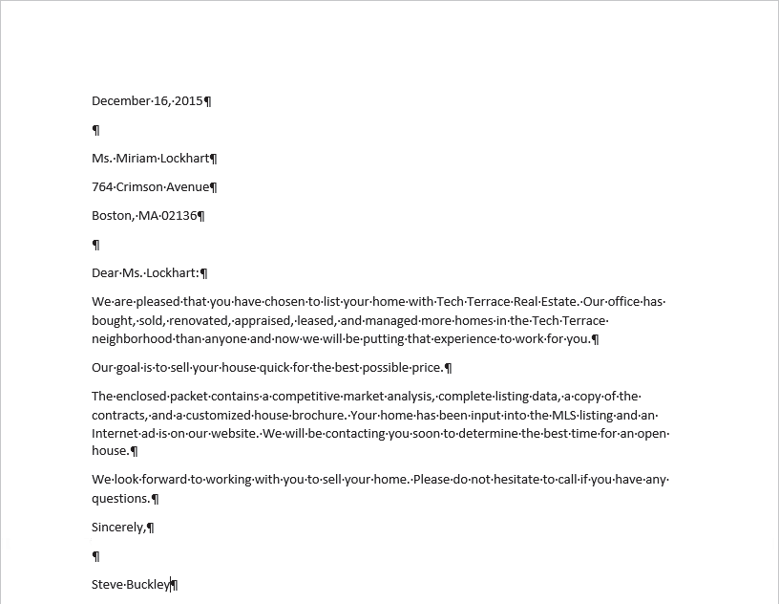
10
Lesson 1
10. Type Steve Buckley. Your document should appear as shown in Figure 1-8. This letter still needs to be formatted in an accepted mailable format and this is discussed in a later lesson.
Figure 1-8
Block Style format with mixed punctuation
PAUSE. LEAVE the document open to use in the next exercise.
Take Note
It is always important to save your document before closing the program. However, if you close the document or Word by accident, a prompt appears, asking whether you want to save your document. Choose Yes to save and close, No to close without saving, or Cancel to stop the Close command.
SAVING A DOCUMENT
By default, newly created documents are saved with a specific filename closely related to the con- tent of the document so that you can locate the file quickly. After editing an existing document, you can choose to save that document with a new filename, a diRerent file format, or in another location. When saving a document to the Cloud, such as OneDrive, you have access to your doc- uments on any computer or tablet and can share them with others. In some cases, you might want to save the original and edited documents in the same place but with diRerent filenames. Keeping the original document enables you to reference it at a future date on any computer.

Slide 11
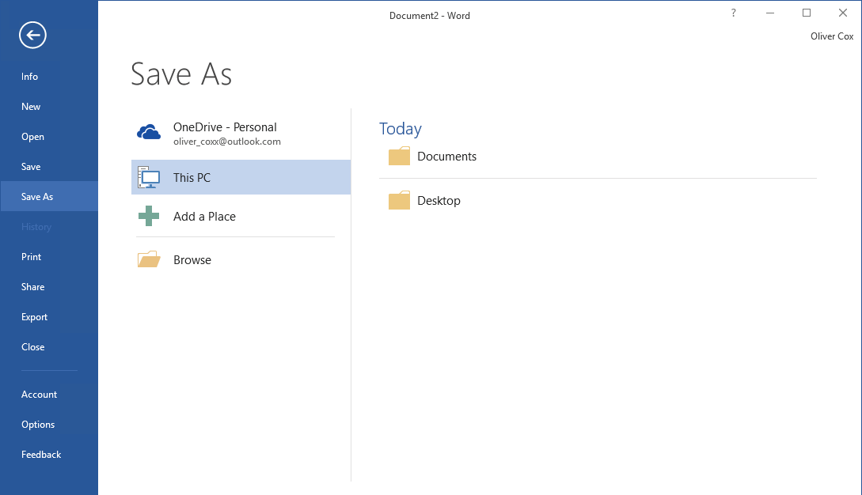
Understanding Word 11
Saving a Document for the First Time
When saving a document for the first time, you must specify a filename, the file type, and a place where you can access the document. The filename should help users find and identify the file, and the file location should be convenient for the file’s future users. You can save files to portable storage devices such as a flash drive, to your computer’s hard drive, to a network location, or to OneDrive.
The Save As command enables users to save their work to the cloud and access the document quickly from any computer or tablet. In Lesson 13, you learn to save documents to OneDrive. In this exercise, you learn to save a document with a specific filename to your flash drive.
STEP BY STEP Save a Document for the First Time
USE the document that is open from the previous exercise.
If necessary, connect your flash drive to one of the USB ports on your computer.
Click the File tab, and then click the Save As command. The Save As screen appears. There are three options available to save your document: OneDrive, This PC, and + Add a Place. Click This PC. The right side of the screen changes and displays Recent Folders that have been opened, as shown in Figure 1-9.
Return to document icon Backstage commands
Figure 1-9
The Save As screen
Click Browse. The Save As combo box appears. In the Windows 10 environment, the Documents Library is the default location for saving new files. Change the location from the default to your flash drive by using the vertical scroll bar and scrolling down until you see This PC. Expand the This PC container and select your flash drive. Storage devices are given a specific letter identified by the operating system. For example, your flash drive might be labeled as Removable Drive (I:).
Click the flash drive to select that as the location to save your document.
By default, the first few characters that you typed in your document appear in the File name box. Drag the mouse over the text and press Delete or begin typing over the highlighted text. Then, type Tech Terrace Letter in the File name box and click Save.
If a prompt appears to upgrade to the newest format click the OK button. This action allows you to use the new features in Word 2016.
PAUSE. LEAVE the document open to use in the next exercise.

Slide 12

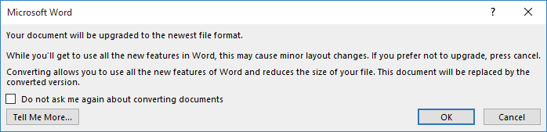
12
Lesson 1
Troubleshooting
AutoRecover is a feature that automatically saves your data at scheduled intervals. Be default, Word 2016 saves your work every 10 minutes. This makes it possible to recover some of your work if a problem occurs. However, this useful option is not a substitute for frequently saving your documents as you work. You should always click the Save button regularly to avoid losing work in case of a power outage or computer crash.
Choosing a Different File Format
Some individuals and companies might not have upgraded their Office suites to the latest version and might still be working in an earlier version, such as Word 2003. Changing the file format of a document enables those individuals and companies to open and edit your document without losing its text formatting. In this exercise, you learn to save a document in a format compatible with an earlier version of Word.
STEP BY STEP Choose a Different File Format
USE the document that is open from the previous exercise.
Click the File tab, and then click Save As to open the Save As screen.
Under Current Folder, click your flash drive. The Save As combo box appears.
In the Save as type box, click the drop-down arrow and choose Word 97-2003 Document (*.doc).
Type Tech Terrace 97-2003 in the File name box. Click Save. On the title bar, the new file name appears, along with a Compatibility Mode designation. In the next exercise, you learn about Compatibility Mode.
PAUSE. LEAVE document open for the next exercise.
Converting a Document
Compatibility Mode enables you to work in a document created in an earlier version of Word without saving the file in a diRerent file format. In this exercise, you learn to use the Convert com- mand to clear the compatibility options and convert a document to the Word 2016 file format.
STEP BY STEP Convert a Document
USE the document that is open from the previous exercise.
With the Tech Terrace 97-2003.doc document open, click the File tab.
In the main pane of the Info command, click Convert, and then click OK to confirm the conversion, as shown in Figure 1-10. Converting the document clears the Compatibility Mode on the title bar and upgrades your document to Word 2016 format, which enables you to access Word’s new features.
Figure 1-10
Convert prompt

Slide 13
Understanding Word
13
To save the document in the Word 2016 file format, click the File tab.
Click Save As, and then click your flash drive. Then in the File name box, type Tech Terrace Update. Click Save. The new filename displays in the title bar.
PAUSE. CLOSE the document and leave Word open for the next exercise.
WORKING WITH TEMPLATES
You can work more efficiently by creating many of your new documents using templates provided by Word. You can choose from many diRerent categories of templates, such as letters, resumes, faxes, labels, cards, calendars, and more. Some templates are preinstalled with Word and there are more options available online. A template is a master document with predefined page layout, fonts, margins, and styles that is used to create new documents with the same basic formatting. Using templates keeps you from having to recreate the layout and formatting of recurring doc- uments, such as letters and interoffice memoranda. Templates are reusable even if you saved the document with a diRerent file name. In this exercise, you locate an installed template, enter infor- mation, and save the document as a template.
Locating a Template Installed on Your Computer
Microsoft continues to add new templates to its categories. If you are looking for a document that contains no formatting, single spacing, and margins at one-inch top, bottom, left, and right, then the Single spaced (blank) document template will do just that. In this exercise, you select this template to create and save a Word document.
STEP BY STEP Locate a Template Installed on Your Computer
GET READY. USE the document that is open from the previous exercise.
Click the File tab, and then click New. The New screen displays the available templates. Scroll down and review the accessible templates. First determine what type of document you need to create. For this exercise, you select a blank template.
Click the Single spaced (blank) document, and then click the Create button.
Click the Show/Hide button (¶) to show paragraph marks.
PAUSE. LEAVE the document open to use in the next exercise.
Creating a Document Using a Template
In this exercise, you use the document you created from the template in the previous exercise to write a memo and save it, not as a template, but as a standard Word file.
STEP BY STEP Create a Single-Spaced Document Using a Template
GET READY. OPEN Word if it is not already open.
Click the File tab, and then click Save As. In the Save As screen, click This PC. Then click your flash drive to open that location. In the File name box, type Welcome Memo. Click Save.
Type the document as follows and press the Tab or Enter key as indicated. By pressing the Tab key twice, you are aligning the text at the one-inch marker on the ruler.
Forest Hills Home Owner’s Association [Press Enter three times.]
To: [Press Tab twice.] New Neighbor Welcoming Committee Members [Press Enter twice.]
From: [Press Tab twice.] Committee Chair [Press Enter twice.]

Slide 14
14
Lesson 1
Date: [Press Tab twice.] December 15, 20XX [Press Enter twice.]
Subject: [Press Tab twice.] Meeting and Refreshment Schedule [Press Enter twice.]
Thank you for volunteering to be on the New Neighbor Welcoming Committee. Enclosed please find the meeting and refreshment schedule for the next six months. See you in January!
3. SAVE the document, then leave open for the next exercise.
PAUSE. LEAVE the document open to use in the next exercise.
Finding Templates on the Internet
Microsoft oRers numerous templates online, and other templates are also available from third-par- ty providers, as well as other users in the community. You can select from a category using the Office.com Templates section or search for a template online by specifying keywords in the Search bar. In this exercise, you select a template category and view a listing of templates online.
STEP BY STEP Find Templates on the Internet
GET READY. Word should be open from the previous exercise.
Click the File tab, and then click New.
In the Search for online templates box, type forms, and then click the Start Searching
button. Additional templates appear. You can also filter the templates by category to narrow your search. Preview by using the scroll bar and select any template. Click Create.
CLOSE the forms template and do not save.
As the assistant to the Tech Terrace Real Estate manager, you are in the beginning stages of gathering the materials together for the annual report. You decide to use one of the available templates in Word 2016. Click the File tab, and then select New.
In the Search for online templates box, type Annual Report (Timeless design), and then click the Start Searching button. Select the template with the image, and then click Create. The template will download.
On the first page, click the drop-down arrow by the [Year] variable and select the current date—note the year displays in the placeholder. As you gather information for the report, you begin entering data into the document.
Click File, and then click Save As. In the Save As dialog box screen, click This PC and select your flash drive.
In the File name box, type Annual Report.
Change the file type by clicking the drop-down arrow and select Word Template. Note that you might need to select your flash drive again because Word automatically saves templates to the Templates folder located on the computer.
Click SAVE.
PAUSE. LEAVE the document open for the next exercise.
Modifying a Template
You might find that a template needs some changes to meet your needs. Rather than making those changes to the document every time you use it, you can choose to modify the template itself. So that you won’t lose access to the original, it is a good idea to save the changed template with a new name.

Slide 15

Understanding Word 15
Whenever you use one of the Microsoft-supplied templates, as in the previous sections, a copy of the template is stored in your personal Templates folder, located by default at C:\Users\username\ AppData\Roaming\Microsoft\Templates. You can modify the template files in this location to create customized versions.
In the following exercise you will make changes to the downloaded copy of the template that you used in the previous exercise.
STEP BY STEP Modify an Existing Template
GET READY. OPEN File Explorer in Windows.
On the File tab, click Open. Then click This PC and click Browse to open the Open dialog box.
Navigate to C:\Users\username\AppData\Roaming\Microsoft\Templates where username is your Windows account name.
Troubleshooting
If you don’t see the AppData folder, turn on the display of hidden files and folders. To do so, open File Explorer and, on the View tab, select the Hidden items check box.
In the Open dialog box, select Annual report (Timeless design).
Click Open. The template opens for editing.
Select the first five lines of text.
On the Home tab, in the Paragraph group, click Center to center the selected lines.
On the File tab, click Save As.
Click Browse. The same folder opens as you selected in step 2.
In the File name box, change the name to Annual report modified.
Click SAVE.
On the File tab, click New. Then click PERSONAL below the Suggested searches line to display your personal templates.
Troubleshooting
If you don’t see thwe PERSONAL heading on the File tab, you will need to do a bit of setup to make it appear. On the File tab, click Options, and click Save. In the Default personal templates location, enter the same path as in step 2 and click OK. You should then be able to resume the procedure at step 11.
Click Annual report modified to start a new document with that template.
Close the new document without saving your changes.
PAUSE. LEAVE Word open for the next exercise.
PREVIEWING AND PRINTING A DOCUMENT
The Print command is located on the File tab in Backstage. There you find the printing options, including printer properties and settings. The Preview pane gives you an opportunity to see what your printed document will look like, so you can correct errors before printing.
Previewing in Backstage
Before printing your document, you need to preview its contents so you can correct any text or layout errors. In this exercise, you learn to use Backstage to preview your document.

Slide 16
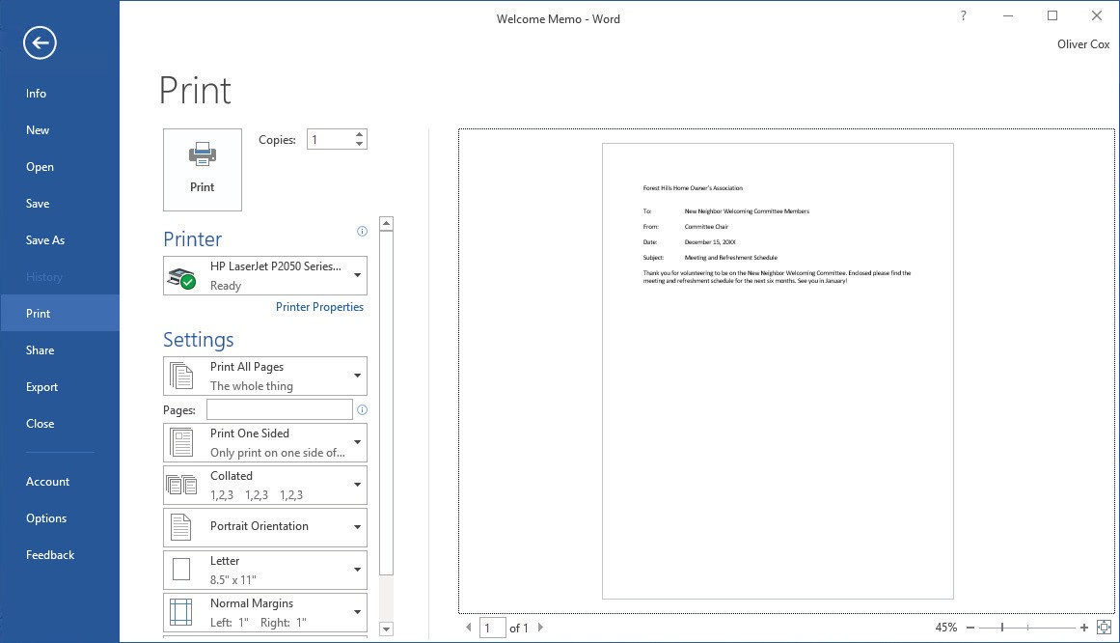
16
Lesson 1
Take Note
The Backstage view is a screen that appears when you click the File tab in Word 2016. While the ribbon contains commands you use while working within a document, the Backstage view contains commands for managing the document. On the left side of the Backstage screen, there are tabs that enable you to create, open, save, close, share, print, and view information about your documents. To exit the Backstage screen, you can click the Return to Document icon, which is a circled left arrow located in the upper-left corner, or press the Esc key. The Print command feature includes three sets of options: Print, Printer, and Settings. Choosing the Print button au- tomatically prints the document to the default printer using the default settings. Use the Copies spin box to change the number of copies to be printed. The Printer options enable you to select an installed printer, print to a file, or change printer properties. Use the Settings options to control document-specific print parameters. For example, you can choose to print only specific pages, change the paper size, and select collation options. You also have access to Page Setup here, where you can change additional settings for the document. You learn more about changing the docu- ment’s layout in Lesson 5.
The Preview screen to the right of the Print options settings enables you to view your document as it will appear when it is printed, so you can make any necessary changes, such as changing the margins or orientation, before printing. The Preview screen lets you preview every page by clicking on the right and left arrows to page through multiple-page documents.
STEP BY STEP Use Print Preview
OPEN the Welcome Memo document that you created earlier.
1. Click the File tab, and then click Print. The Print screen opens with the Print options on the left and the Print Preview on the right, as shown in Figure 1-11.
Figure 1-11
Print options and Print Preview screen
Print commands
Page selector
Print preview
Zoom slider

Slide 17
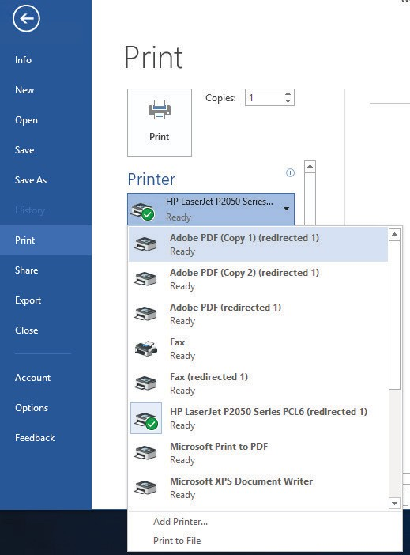
Understanding Word 17
Click the plus symbol (+) on the Zoom slider located on the bottom-right of your screen until the zoom level changes to 100%.
Click the Return to Document icon or press the Esc key to close Backstage.
Click the File tab, and then click SAVE. Your document will be saved with the same
filename on your flash drive.
PAUSE. LEAVE the document open to use in the next exercise.
Choosing a Printer
If your computer has access to multiple printers, you might need to choose a destination printer for your document. If your printer is already set up and ready to print, as is the case in most class- room environments, you do not need to complete this exercise. Otherwise, follow this exercise to choose a printer.
Take Note
Before printing your document, check with your instructor.
STEP BY STEP Choose a Printer
USE the document that is open from the previous exercise.
Figure 1-12
Click the File tab, and then click Print.
In the Printer selection area, click the drop-down arrow to produce a list of all printers connected to your computer (see Figure 1-12).
Available printers
Available printers
3. Select a printer, and then click the Print icon.
PAUSE. LEAVE the document open to use in the next exercise.

Slide 18
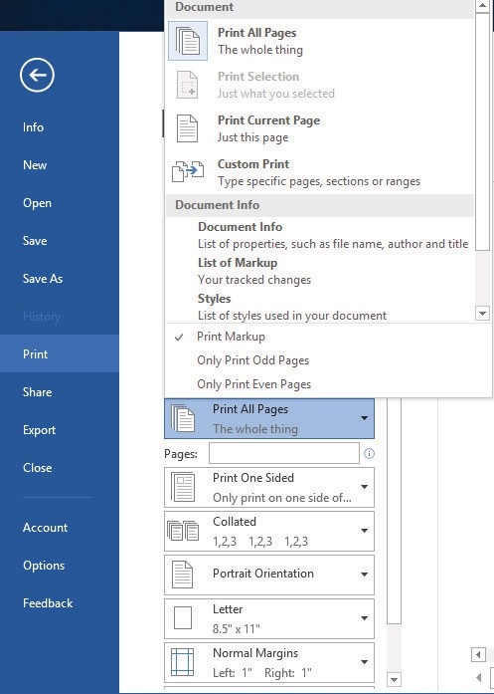
18
Lesson 1
Setting Print Options
Print options enable you to select the number of copies to be printed; to print only selected con- tent, the current page, or a custom range of pages; and to select from a number of other options for printing properties, collation, and page layout. Changes to Settings options apply to the current document. In this lesson, you learn how to change the Settings options before printing. (Check with your instructor before printing this exercise on a lab printer).
STEP BY STEP Set Print Options
USE the document that is open from the previous exercise.
1. Click the File tab, and then click Print. Click the drop-down arrow on Print All Pages to produce the menu shown in Figure 1-13.
Figure 1-13
Print options
Print settings
Select Print Current Page, and then click the Print icon. Selecting this option prints the current page.
Return to the Print screen area. In the Copies section of the Print options area, click the up arrow to select 2, and then click the Print icon.
Place your insertion point at the beginning of the first paragraph, and then hold down the left mouse button and drag to the end of the paragraph to select it.
Click the File tab, and then click Print. Click the Print Current Page drop-down arrow, select Print Selection, and then change the number of copies from 2 to 1 by clicking the down arrow. Next, click the Print icon. The selected paragraph is printed.
Click the File tab, and then click Close to close the document.
The Annual Report document should still be open from a previous exercise. Click the File tab, and then click Print. Under Settings, click the drop-down arrow by 1 Page Per Sheet and select 2 Pages Per Sheet, and then click the Print icon. This eight-page document is now printed on four pages with two pages per sheet.
Click the Close button to close both the document and Microsoft Word.
STOP. CLOSE Word.

Slide 19
Understanding Word 19
Knowledge Assessment
Multiple Choice
Select the best response for the following statements.
The first screen you see when you open Word 2016 is called the:
Word screen
Recent screen
Start screen
Screen saver
Which of the following contains the commands you use most often, such as Save, Undo, and Repeat.
Quick Access Screen
Quick toolbar
Quick Access Toolbar
Quick command
The headings that appear on the Ribbon, such as File, Home, and Insert, are called:
groups
tabs
shortcuts
menus
Which command would you use to save a document for the first time?
Save
Save As
Save for th e first time
Either a or b
Which of the following options would you use when saving a document with a new filename?
Save
Save As
Ctrl+S
Either a or b
True/False
Circle “T” if the statement is true or “F” if the statement is false.
T F 1. When you start Word 2016, a new blank document appears.
T F 2. Clicking the Print button on the Backstage Print screen sends the document straight to the currently selected printer with the default settings.
The File tab can be used to save and print files.
You can hide the Ribbon by double-clicking the active tab. Previewing and printing can be completed by accessing Backstage.
T F 3.
T F 4.
T F 5.

Slide 20
20 Lesson 1
Projects
Project 1-1: Typing a Business Letter
You work for Proseware, Inc., and need to send a follow-up letter regarding price quotes. Create the following letter in block style with mixed punctuation.
GET READY. LAUNCH Word if it is not already running.
When Word 2016 opens, the Recent screen appears. Click Single spaced (blank)
document. Click Create.
Click the File tab, and then click Save As. In the Save As screen, click This PC, and then click Browse. Use the vertical scroll bar to locate your flash drive. Create a folder on the flash drive and name it Lesson 1 Projects. Double-click to open the folder.
In the File name box, type 1-1 Quotes. Click Save.
Display the Show/Hide nonprinting characters. At the insertion point, type January 10, 20XX.
Press Enter four times to create blank lines.
Type the recipient’s address as shown:
Mr. David Pacheco (Press Enter once.) A Datum Corporation (Press Enter once.) 2133 Montana (Press Enter once.) El Paso, TX 79938 (Press Enter twice.)
Type the salutation Dear Mr. Pacheco:
Press Enter twice.
Type the body of the letter:
It was our pleasure meeting with you last week to discuss quotes for the components you requested. As agreed upon, the specifications discussed will be provided to you once we receive final approval from you.
Press Enter twice.
Type At Proseware, Inc., we appreciate your business.
Press Enter twice.
Type the closing Sincerely,.
Press the Enter key four times.
Type Joe Villanueva.
Proof your document carefully.
Click the File tab, and then click SAVE. The updated version of the letter will be saved with the same filename in the lesson folder on your flash drive.
PAUSE. LEAVE the document open for the next project.
Project 1-2: Printing a Document
After proofing the letter you just wrote, you are ready to print copies of the document.
GET READY. LAUNCH Word if it is not already running.
Use the 1-1 Quotes document you created in Project 1-1.
Click the File tab, and then click Print. In the Copies section of the Print options area, click the up arrow to change the number of copies from 1 to 2.
Click the Print icon.
Click Save on the Quick Access Toolbar.
Click the File tab, and then click CLOSE.
STOP. CLOSE Word.

